Slide 1
Getting to know your Office 365
Email Training

Slide 2
Have you ever posted or sent a message that you regret?

Slide 3
Why office 365 and email?
Learn “Soft Skills”
Communicating effectively through email

Slide 4
Learning intentions
Discuss appropriate email use (not private)
Discuss how to send an email

Slide 5
Success criteria
I can log in to my email.
I can state one "Do" and one "Don't" about my student email.
I can open a new email.
I can address an email to my teacher.
I can write a subject in the "Subject" line & compose a message.
I can send the email to my teacher.

Slide 6
Login and email address
Single sign on
When you log into the computer you are logged into your email account
Always log off the computer
Never share your account
Why is this so important?
This Photo by Unknown author is licensed under CC BY-NC.

Slide 7
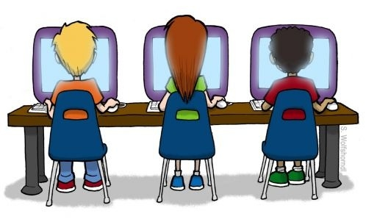
Corporate email account
What does that mean?
Not a personal account
Not private
School officials can access your account at any time
It is monitored and filtered

Slide 8
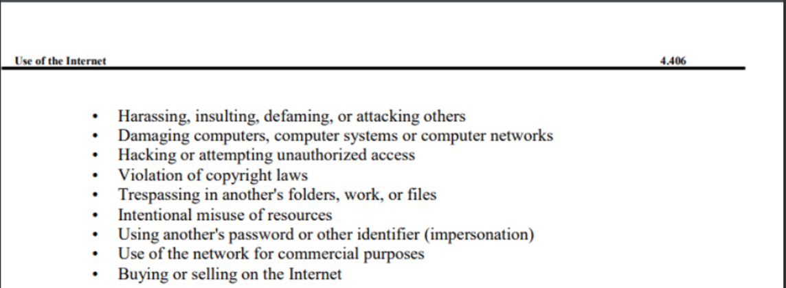
LINK TO RCS Use of the Internet Policy

Slide 9
If any of these things happen above while a student is logged onto their device or under their username it always gets flagged and sent straight to your school principal - emails, searches, etc.
School emails are not private and are monitored at all times.
* MOST IMPORTANT: IF YOU THINK IT COULD GET FLAGGED, IT WILL PROBABLY GET FLAGGED!

Slide 10
Accessing your account
Go to https://portal.office.com/
Your email address is username@student.rcschools.net
jdoe1234@student.rcschools.net

Slide 11
Accessing Your Outlook Student Email
Go to https://portal.office.com/ Your email address is username@student.rcschools.net
Outlook will open your student email account.

Slide 12
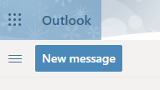
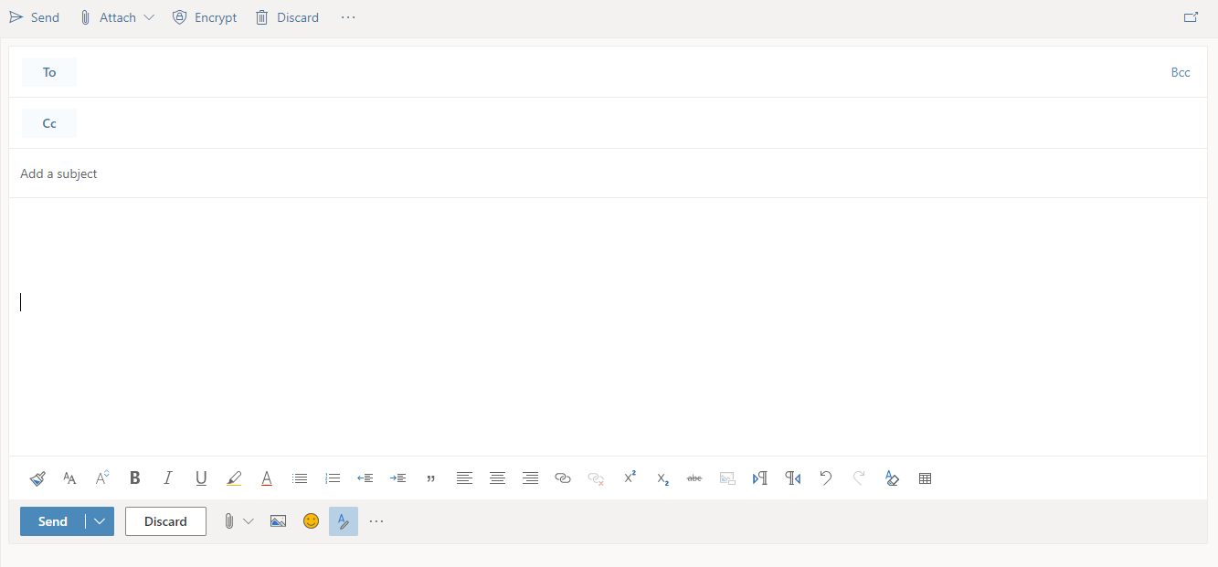
Click New message to open a new email message
Type the intended recipient email address here.
Type the subject of your email here.
Type the body of your email here.
Click here to attach a file
Click Send
Click Discard to delete message

Slide 13
Email Etiquette

Slide 14
When or how would you use email?

Slide 15
Email Etiquette -- The Do's and Don'ts of Proper Email
Do not use all capital letters!
When you use ALL CAPS, it conveys the feeling of anger or shouting to most people
Also, do not use too many exclamation points!!!!!
Dear Mrs. Smith:
I CAN'T POSSIBLY GET MY ESSAY DONE BY FRIDAY! THERE'S JUST NOT ENOUGH TIME FOR ME TO GET IT DONE!!!!!!!!!!

Slide 16
Email Etiquette -- The Do's and Don'ts of Proper Email
Keep it polite!
Be polite – do not use insulting language
If you are upset, wait until you have calmed down to send an email.
Mrs. Smith,
You are the worst teacher! I can't believe that you would expect us to write an essay in just two days!

Slide 17
Email Etiquette -- The Do's and Don'ts of Proper Email
Read over before you send!
Make sure you have no spelling errors or grammatical mistakes.
Be sure you have not made your email too emotional or angry.
Deer Ms. Smithe:
I am just tearing my hair out trying to figure out how to tell you that I cant finish my assay in time. I am TOTALLY freaking out hear!

Slide 18
Email Etiquette -- The Do's and Don'ts of Proper Email
Do not use abbreviations or slang.
An email is not the same as texting. Don't use abbreviations.
Don't use slang words when writing an email to a teacher, official, or someone older than you
hey mrs. smith:
i just cant get it 2gether 2 get my stuf dun this week. Could u cut me sum slack on the due date 4 tht essay? thx

Slide 20
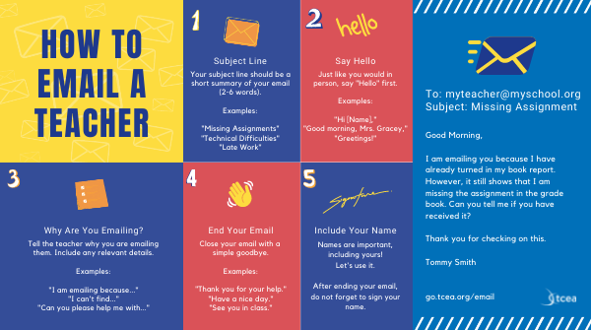

Slide 21
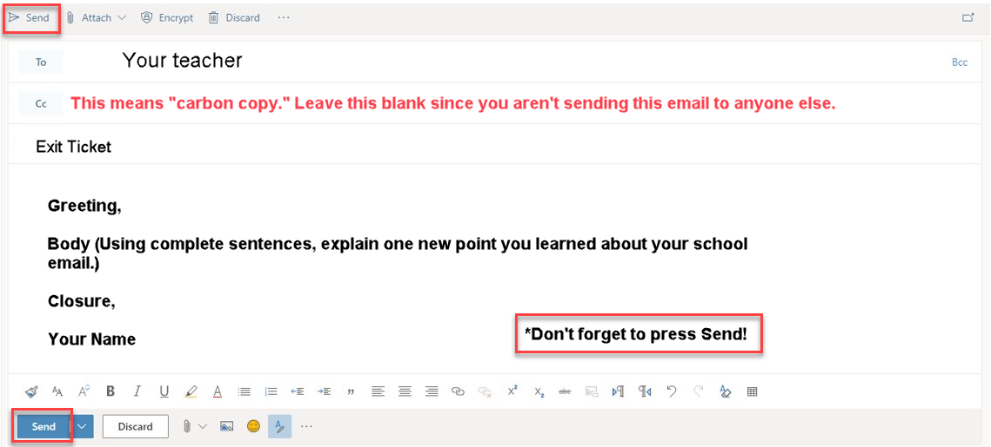
Exit ticket
Open a new email document
To Your Teacher
Subject Exit Ticket
Body (Answer the question below) In complete sentences, explain one new point you learned about your school email.
Closure – sign email with your full name.

Slide 22
Access Email from your Phone
Go to the app store for your device
Search for Microsoft Outlook
Download the app
Sign in with your Office 365 login

Slide 23
Additional Resources for Teaching Email Etiquette
Email Writing for Students • TechNotes Blog (tcea.org)
7 Best Lesson Plans for Teaching Email in Middle School (aeseducation.com)
20 Teaching Ideas About Email Writing | TESOL Blog

